Slide 1
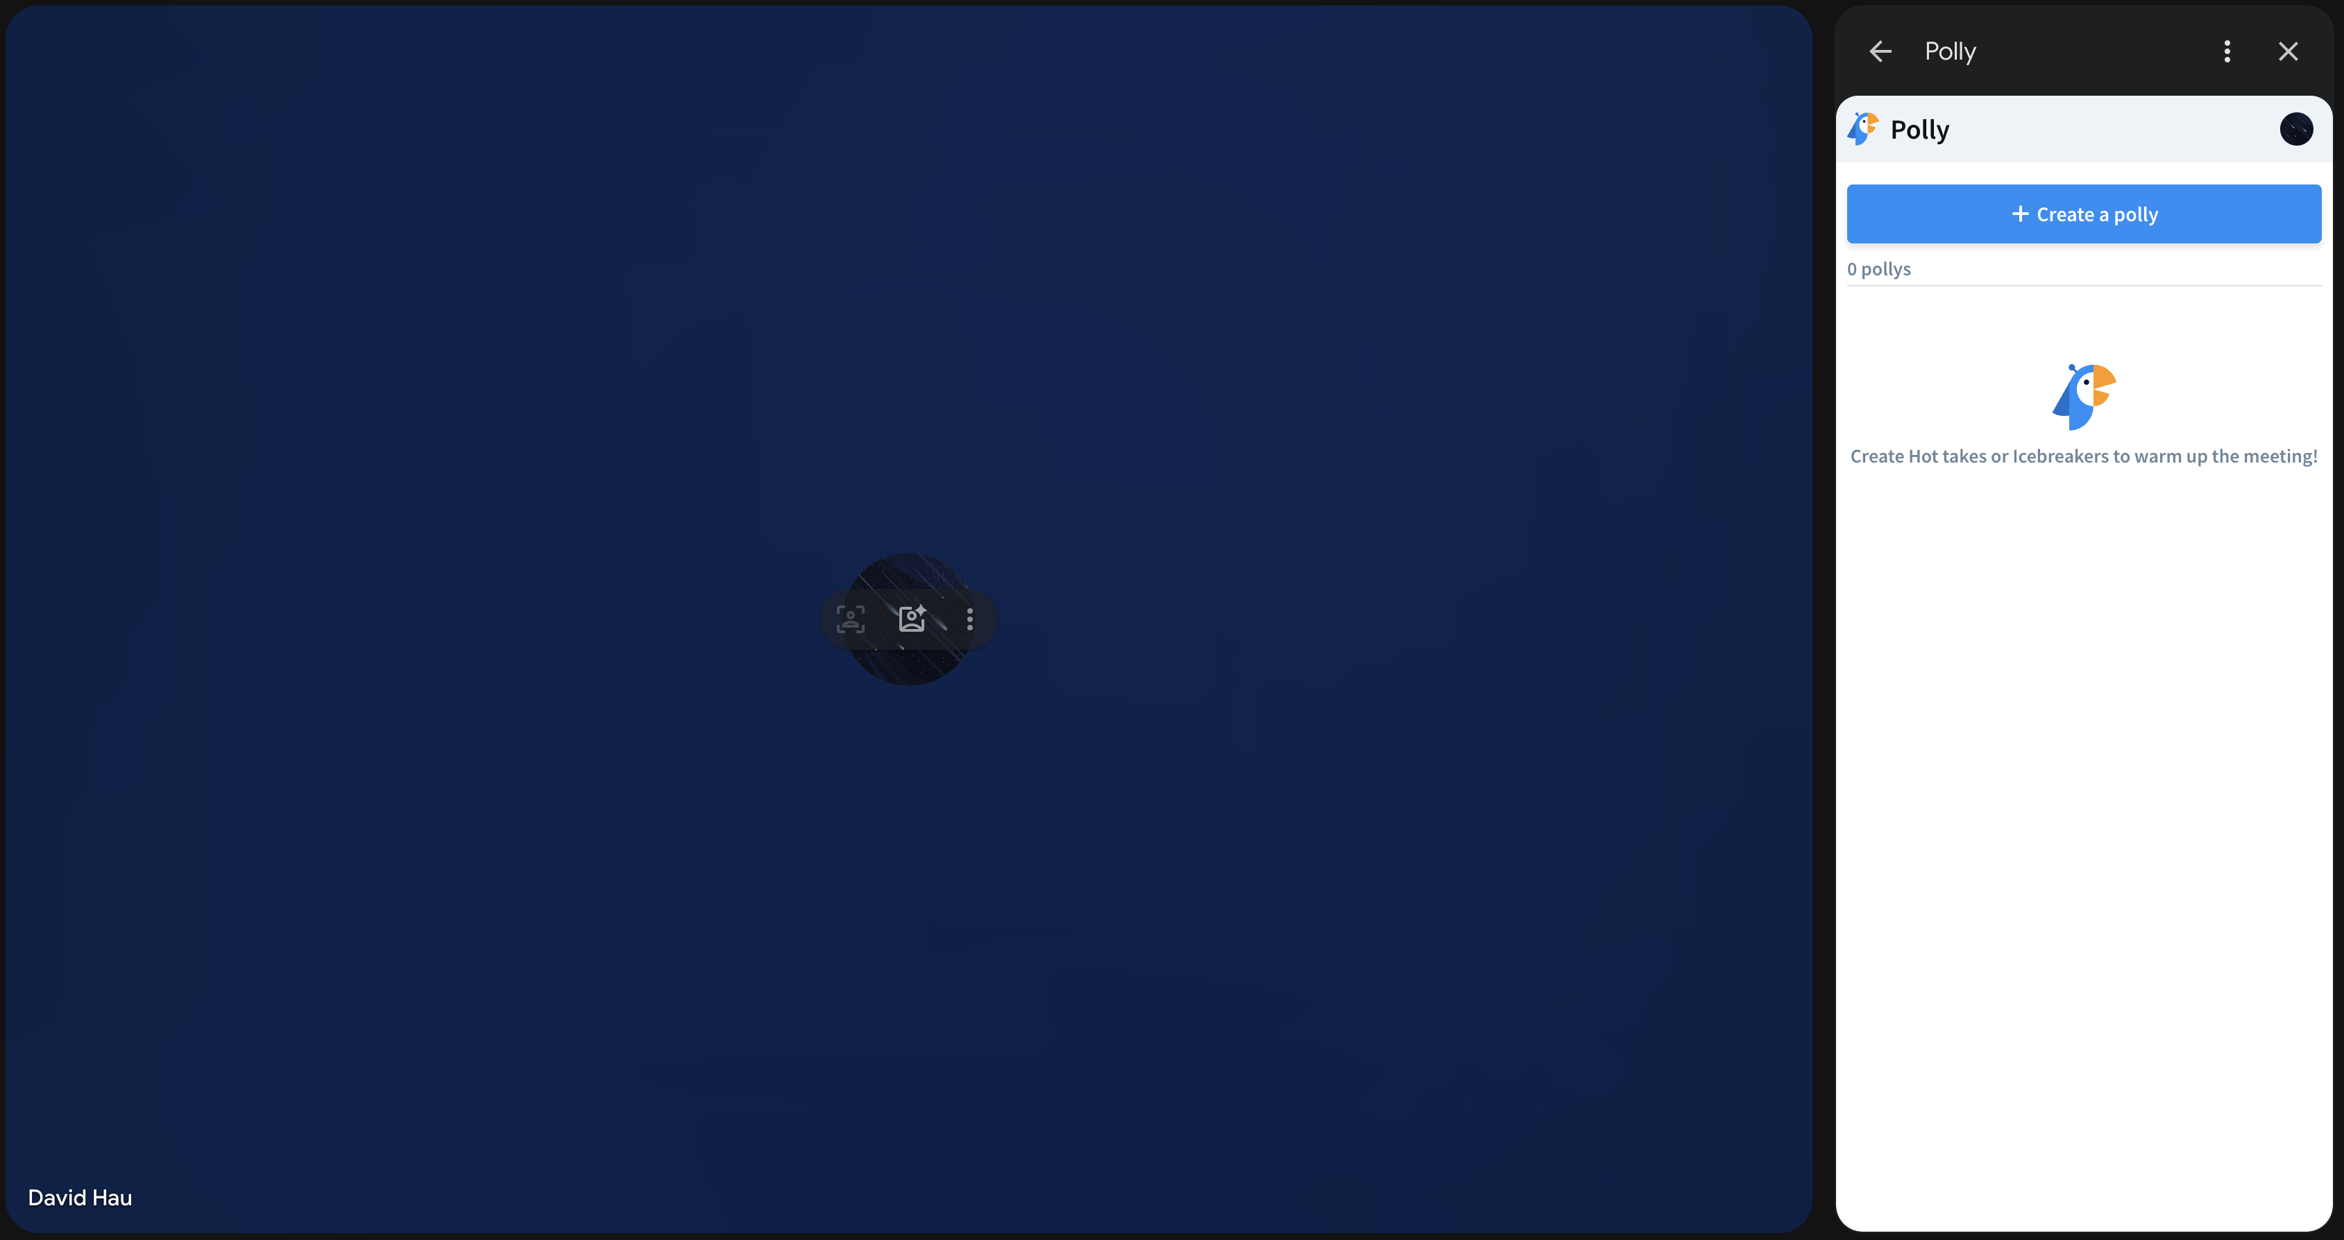
InGroups
Main meeting window with participants
InGroups
Game window – launches in sidebar of Google Meet

Slide 2
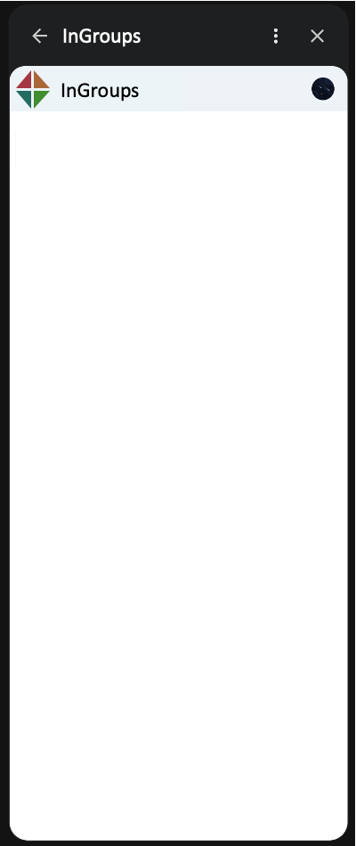

Start Screen - App Initiator Default View
Start Screen - App Initiator Select Word Set
Start Screen – License Key (no license)
Start Screen – License Key (valid license)
# of Groups
3
# of Groups
3
# of Groups
3
# of Groups
3
Select Word Set
Select Word Set
License Key
License Key
Subscribe for more word sets and to create your own!
Enter License Key:
Current License:
Start Game
Animals
xxxx-xxxx-xxxx-xxxx-xxxx
1234-5678-9012-2345-6789
Objects
Random icon
New Set 1
Activate
Create Word Sets
Countries
License Key
Celebrities
No license – go to the (store) to get a license and unlock expanded word sets, play with others that have expanded word sets, and create your own word sets!
Enter License Key:
Colors
xxxx-xxxx-xxxx-xxxx-xxxx
Numbers
Activate
How to Play
Other Category
You already have a license. Activating another license will give you another random icon.
Grab Bag

Slide 3
Start Screen – Create Word Set (no license)
Start Screen – Create Word Set – create new
Start Screen – Create Word Set – edit existing
# of Groups
3
# of Groups
3
# of Groups
3
Create Word Set
Create Word Set
Create Word Set
Subscribe to create your own word sets!
Create New…
New Set 1
Create New…
Delete
New Set 1
Save
New Set 1
Save
Paste in a set of words, or type words one by one (min 20):
Paste in a set of words, or type words one by one (min 20):
apple
banana
cookie
dough
egg
flour
apple
banana
cookie
dough
egg
flour

Slide 4
Game Screen Before Start – Host View
Game Screen Before Start – Host View (Scoreboard)
Game Screen Before Start – Participant View
Word Set: Animals
Word Set: Animals
Word Set: Animals
Start Round
Start Round
Waiting for host to start.
Shuffle Groups
Shuffle Groups
Shift Groups
Shift Groups
Scoreboard
Scoreboard
Scoreboard
In Group
Reset Scores (host only, double confirm)
In Group
Alex
Brian
Christie
R
Alex Lastname
0
Alex
Brian
Christie
R
Brian Lastname
0
Out Groups
Out Groups
R
Christie Lastname
0
Dave
Evan
Frankie
Dave
Evan
Frankie
R
Dave Lastname
0
R
Evan Lastname
0
George
Harold
Irene
George
Harold
Irene

Slide 5
Game Screen During Round – Host View
Game Screen During Round – Participant View
Game Screen During Round – Host/Participant Out Group
4:57
4:57
4:57
Round started. You are (IN GROUP). Talk with your group, try to align on a word below without tipping off the OUT GROUPS!
Round started. You are (IN GROUP). Talk with your group, try to align on a word below without tipping off the OUT GROUPS!
Round started. You are (OUT GROUP). No talking, listen to the IN GROUP to see if you can guess their word!
Guess:
Dog
Guess:
Dog
Guess:
Dog
Round ends after all participants have selected a guess, or after 5 minutes.
Round ends after all participants have selected a guess, or after 5 minutes.
Round ends after all participants have selected a guess, or after 5 minutes.
End Round (host only, double confirm)
Alpaca | Bat | Camel | Dog | Elephant
Frog | Guinea Pig | Horse | Iguana | Jackal
Kiwi | Lemur | Monkey | Newt | Owl
Parrot | Quill | Rat | Snake | Tapir
Alpaca | Bat | Camel | Dog | Elephant
Frog | Guinea Pig | Horse | Iguana | Jackal
Kiwi | Lemur | Monkey | Newt | Owl
Parrot | Quill | Rat | Snake | Tapir
Alpaca | Bat | Camel | Dog | Elephant
Frog | Guinea Pig | Horse | Iguana | Jackal
Kiwi | Lemur | Monkey | Newt | Owl
Parrot | Quill | Rat | Snake | Tapir
Scoreboard
Scoreboard
Scoreboard
In Group
In Group
In Group
Alex
Brian
Christie
Alex
Brian
Christie
Alex
Brian
Christie
Out Groups
Out Groups
Out Groups

Slide 6
Game Screen After Round / Between Rounds – Host View
Game Screen After Round / Between Rounds – Participant View
Round over! All participants can discuss hints, guesses, stories, etc.
Round over! All participants can discuss hints, guesses, stories, etc.
Start Round
Waiting for host to start next round...
Shuffle Groups
Shift Groups
Scoreboard
Scoreboard
In Group
In Group
Alex | DOG | +0
Brian | DOG | +0
Christie | BAT | +0
Alex | DOG | +0
Brian | DOG | +0
Christie | BAT | +0
Out Groups
Out Groups
Dave | DOG | +2
Evan | DOG | +2
Frankie | DOG | +2
Dave | DOG | +2
Evan | DOG | +2
Frankie | DOG | +2
George | DOG | +1
Harold | DOG | +1
Irene | IGUANA | +1
George | DOG | +1
Harold | DOG | +1
Irene | IGUANA | +1

Slide 7
#A43741
ig
ig
#AA6839
#246B61
#408E2F
#262626
#FFFFFF

